Slide 1
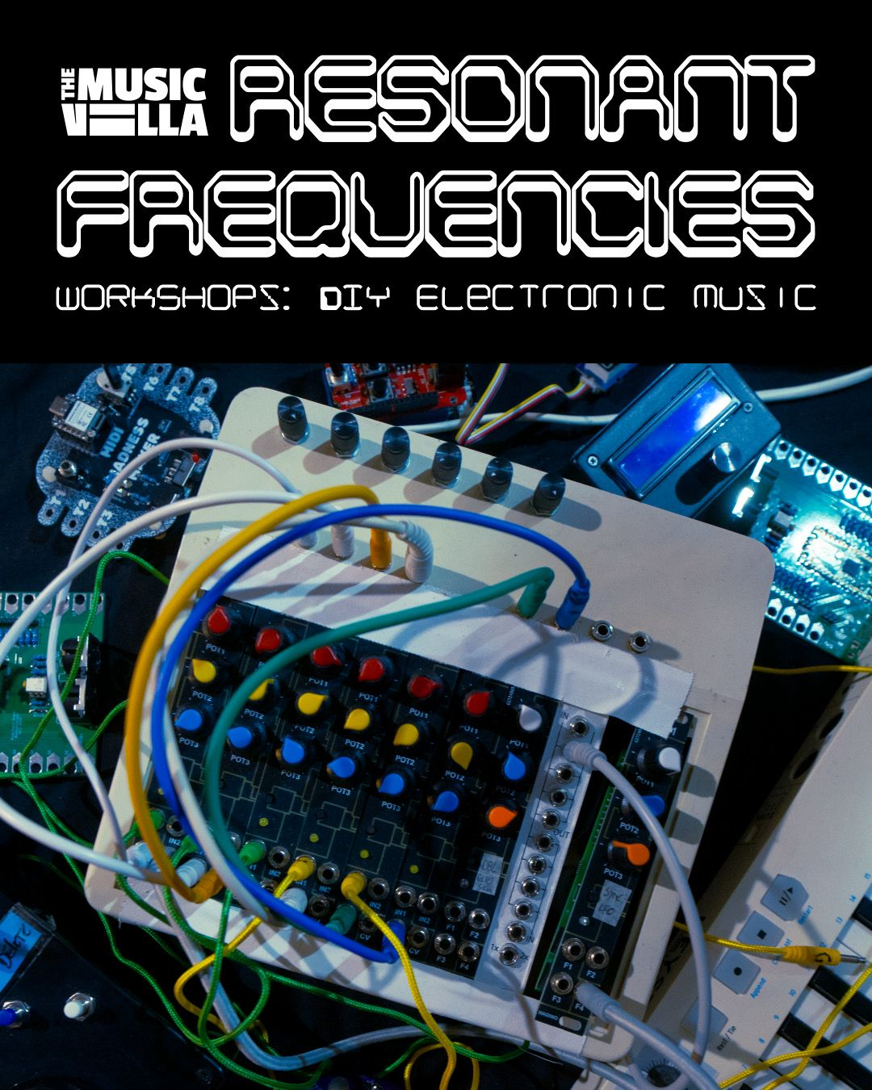
Arduino &
MIDI
DIY MIDI controllers

Slide 2
Introduction to MIDI & Arduino
Midi Tutorial
Arduino Getting Started
Leonardo Tutorial
Example code for the workshop

Slide 3
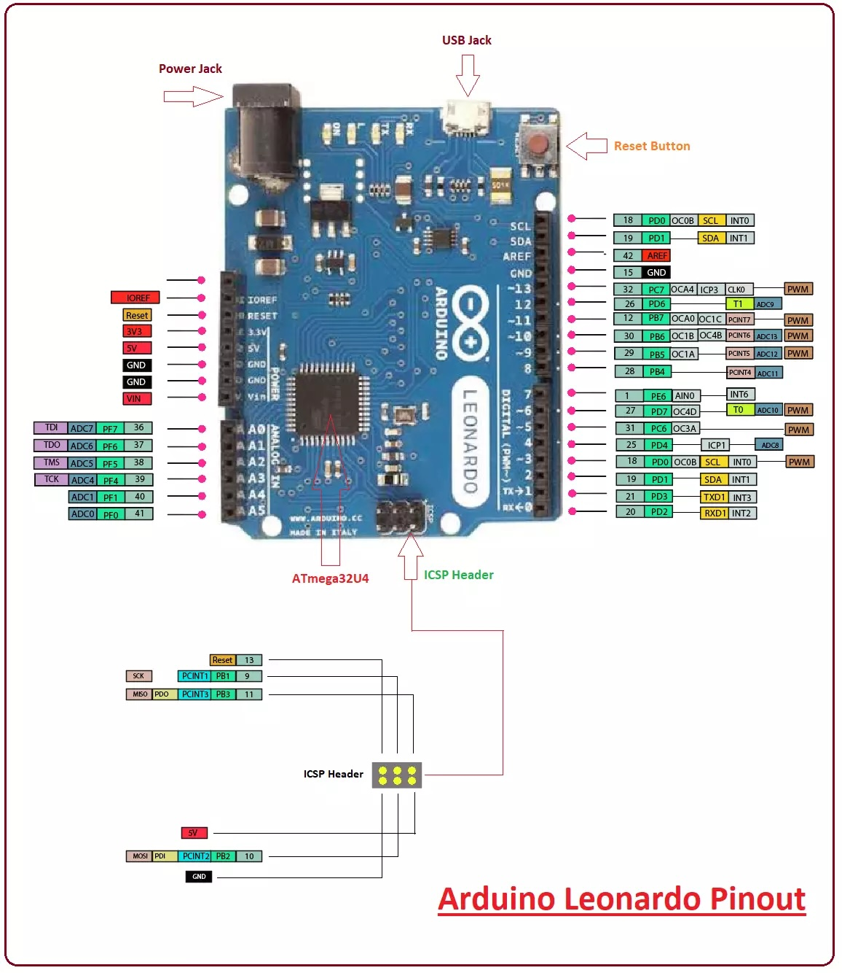
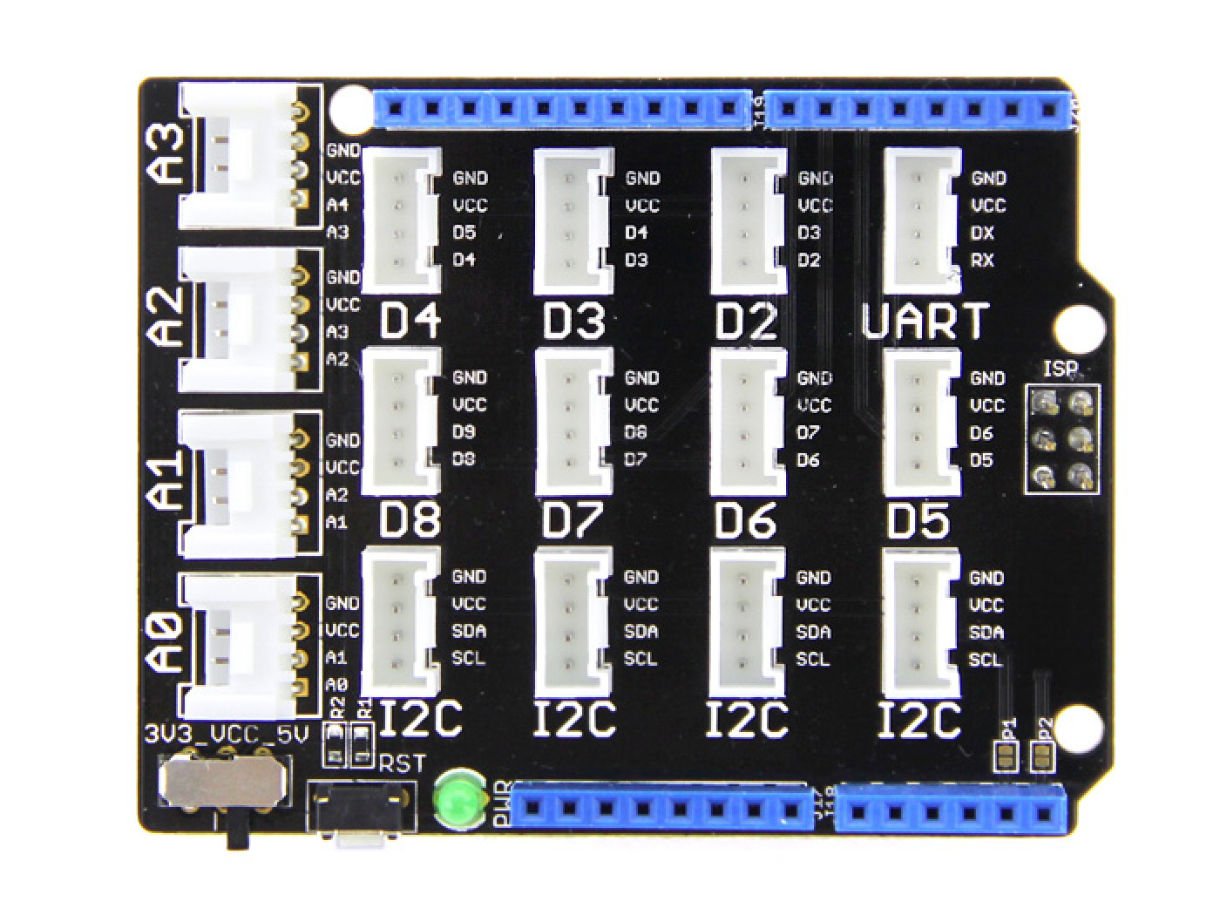





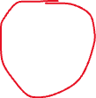
Arduino Leonardo + Grove shield
LED
MIDI INTERFACE
Touch button
LDR
DISTANCE SENSOR
Potmeter

Slide 4
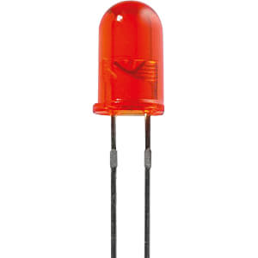
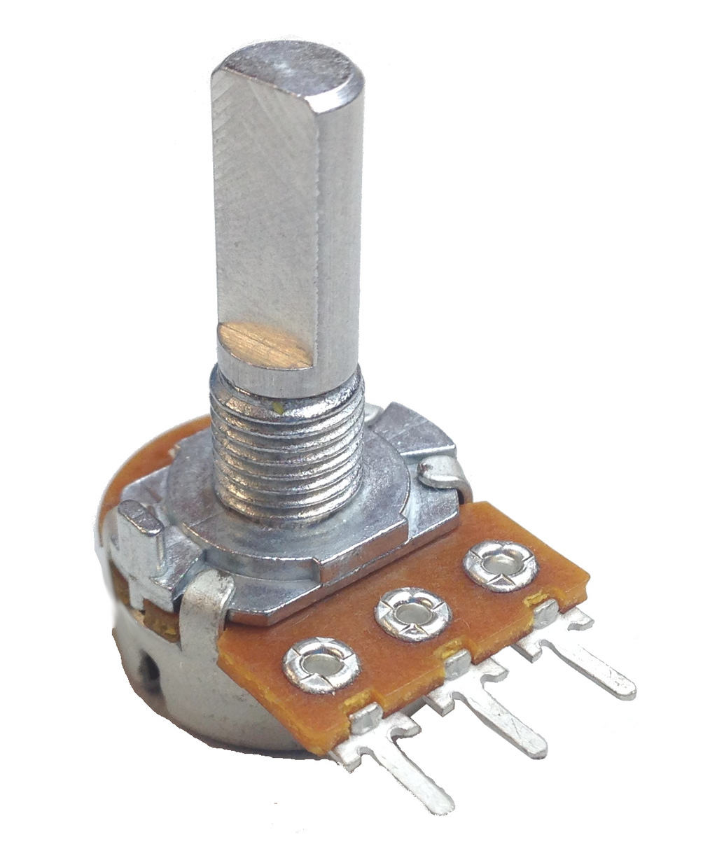
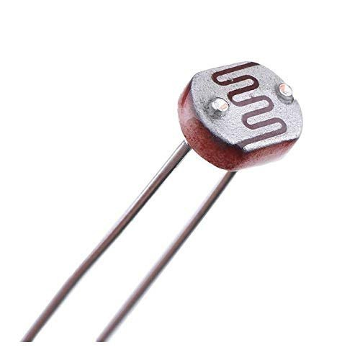
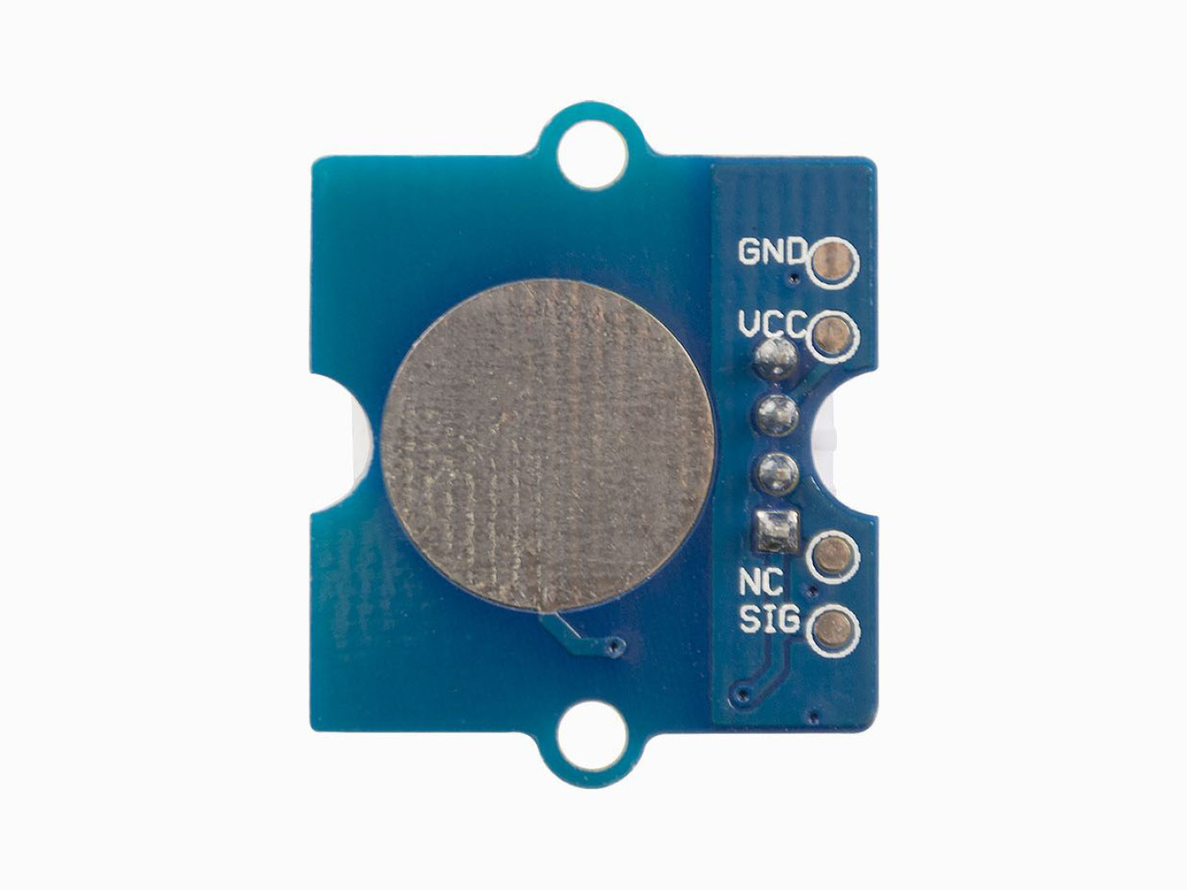
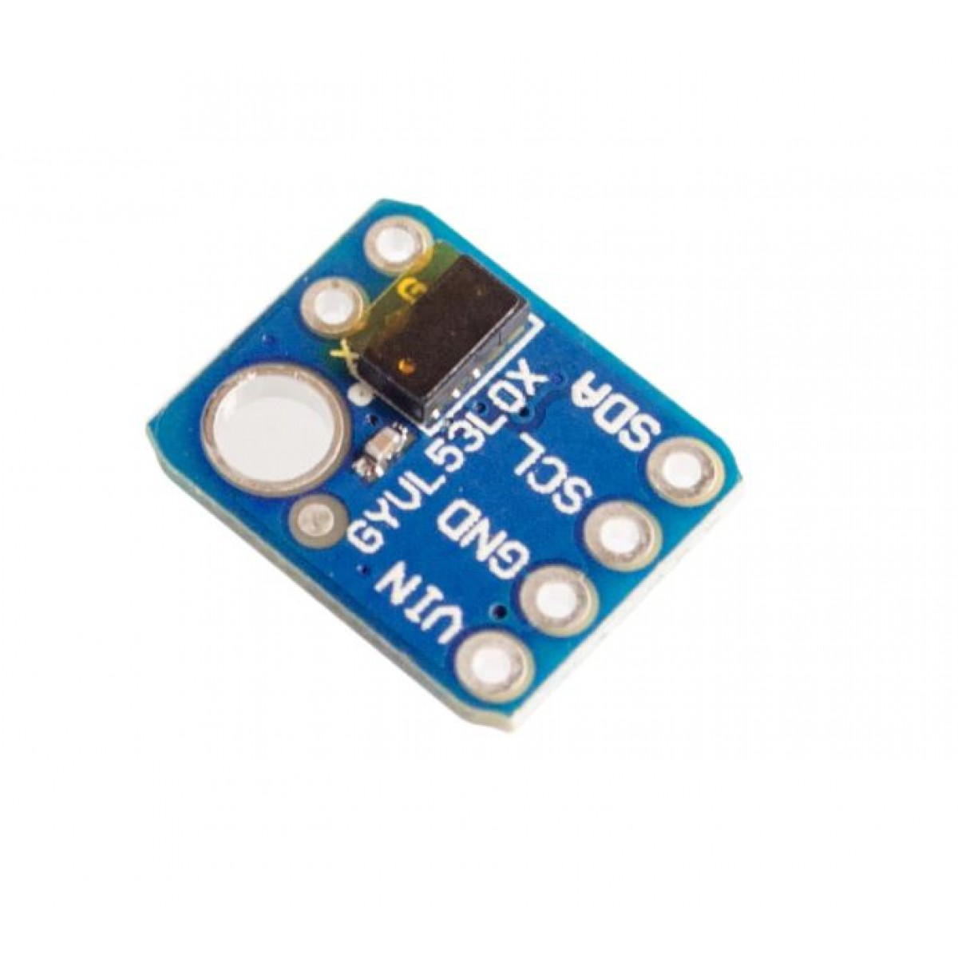
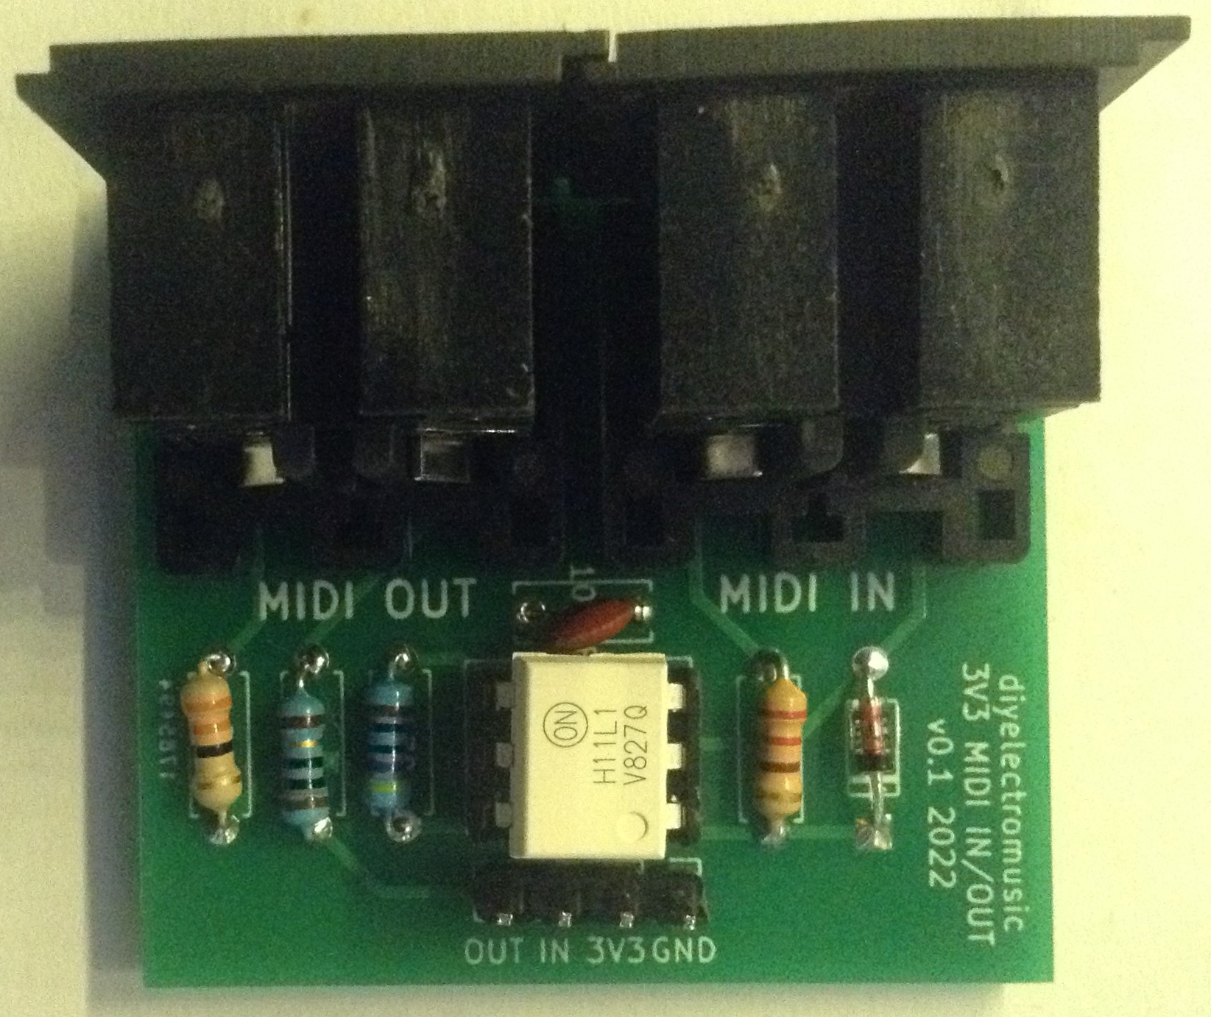
Sensors & MIDI interface used

Slide 5
MIDI commands used in examples
Note On/Off = Note No. (0-127 ), velocity ( 0 -127 ) ,
channel (1 – 16)
Control Change = Controller No. ( 1 – 127 ), value ( 0- 127),
channel ( 1- 16)
MIDI Clock / Start / Stop/ Continue

Slide 6
To be sure !
Don’t connect anything while powered through USB
Don’t set the switch on the shield to 5V..keep it on 3.3V
Make sure the sensors do not touch anything metal
Ask if not sure ;-)

Slide 7
Have Fun and Rock On !

